Slide 1
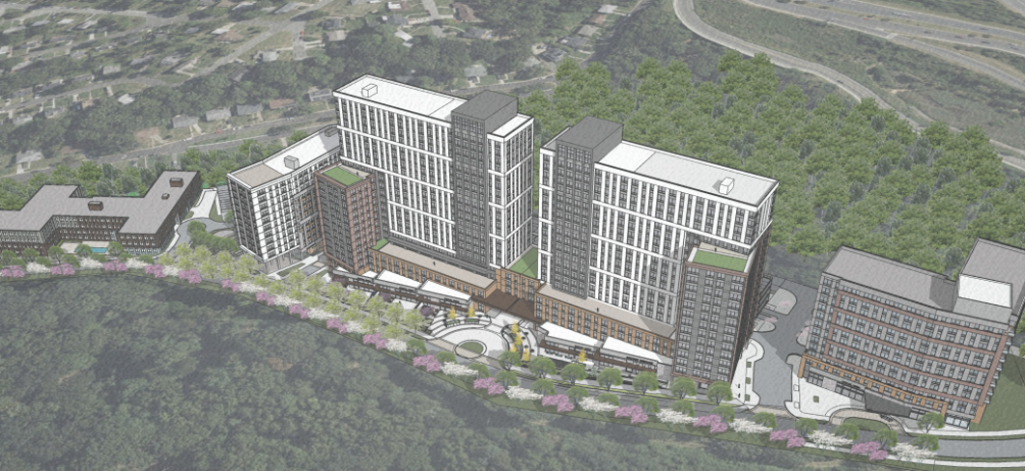



TOWN OF FOREST HEIGHTS GROWTH
PREPAREDNESS PLAN
Community Meeting 1
October 26, 2026

Slide 2

Agenda
Connor Klein, Planner III, Project Manager
Aaron Stiegler, Planner I, Deputy PM
Josephine Selvakumar, Supervisor
Welcome and Introductions
Project Overview
Project Goals, Objectives and Timeline
Map Exercise & Interactive Stations
Next Steps, Questions and Closing
Project Team
Ethan Conner-Ross, Principal-in-Charge
Yihan Zhang, Project Manager
Project Team
Courtney Powell, Urban and Community Planning Manager
Pamela Nkwantabisah, Planner

Slide 3
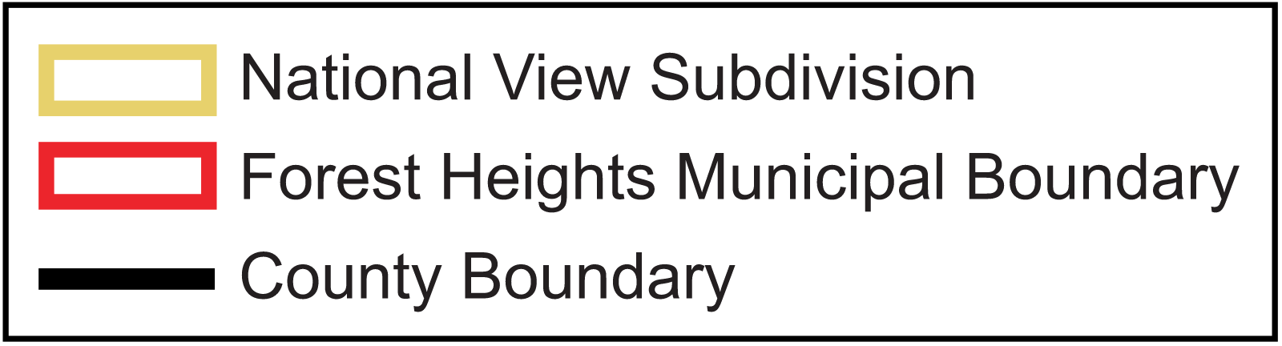
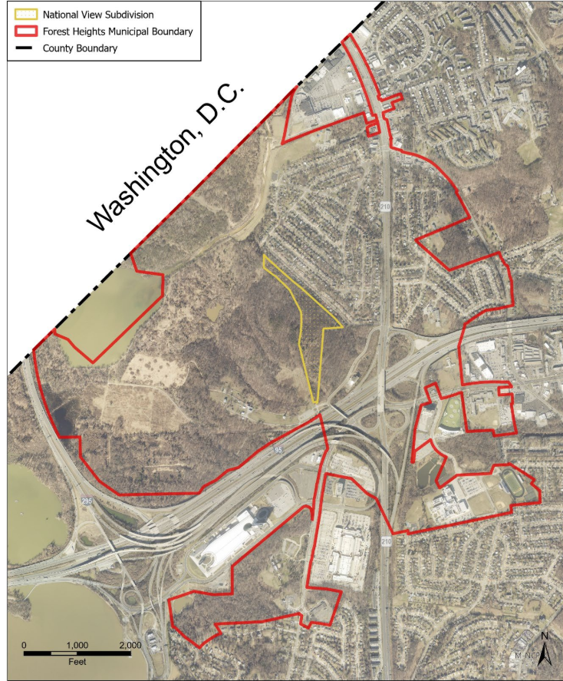
Growth Preparedness Plan
PROJECT OVERVIEW
  9-month project (July 2026 - March 2027)
  Assess growth impacts on municipal services, infrastructure, facilities, and public spaces.
  Evaluate fiscal impacts, including new revenues and additional costs.
  Identify cultural, civic, and social assets to preserve and strengthen.
  Develop phased, actionable strategies to help the Town respond to growth.
Washington, DC
Source: M-NCPPC Applications DSP-24012, DDS-24004, AC-25004, TCP2-013-2025

Slide 4
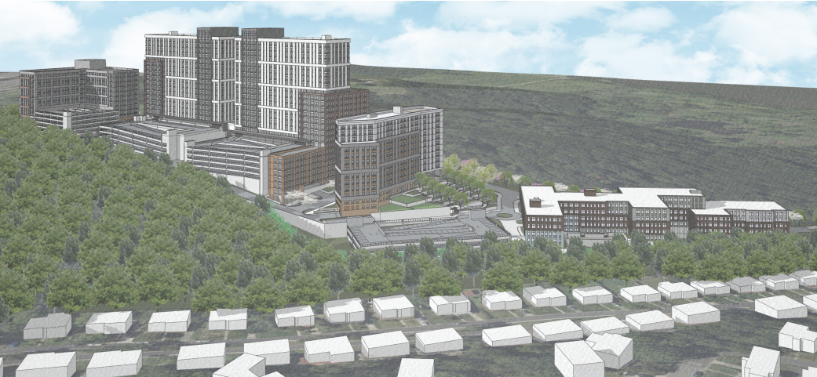
National View
GROWTH AREAS
  21-acre site: Approved mixed use development
  1,495 multifamily units (inclusive of 485 senior housing units)
  Commercial: ≈34K sqft | Day care : ≈ 4.5K sqft | Office : ≈1.4K sqft
  Estimated full buildout: 2037
  Multiple phases: 1A, 1B, 2, 3, 4, 5, 6
Source: M-NCPPC Applications DSP-24012, DDS-24004, AC-25004, TCP2-013-2025

Slide 5
PROJECT GOALS & OBJECTIVES
PROTECT:
Identify existing community cultural resources for preservation and protection.
PREPARE:
Anticipate infrastructure, fiscal, and service impacts caused by population increase.
IMPLEMENT:
Develop practical implementation strategies to manage municipal fiscal and service impacts.
ASSESS:
Evaluate municipal service capacity, operational readiness, and potential implications for ward representation and boundaries.
STRENGTHEN:
Identify ways to strengthen the Town’s identify, cultural assets and community cohesion
PLAN:
Determine how and to what extent municipal government and services need to grow.

Slide 6
PROJECT TIMELINE
Work Plan Task
Jul
Aug
Sep
Oct
Nov
Dec
Jan 27
Feb 27
Mar 27
1 · Kickoff & Work Plan
2 · Plan Initiation & Field Tour
3 · Existing Conditions Assessment
4 · Community Engagement
We are here
5 · Draft Plan & Presentation
6 · Final Plan
Task Duration

Slide 7
How to Participate Today!
  Visit each theme station
  Share your bold ideas
  Participate in map exercises
  Ask questions
  Sign up for upcoming events and additional information

Slide 8
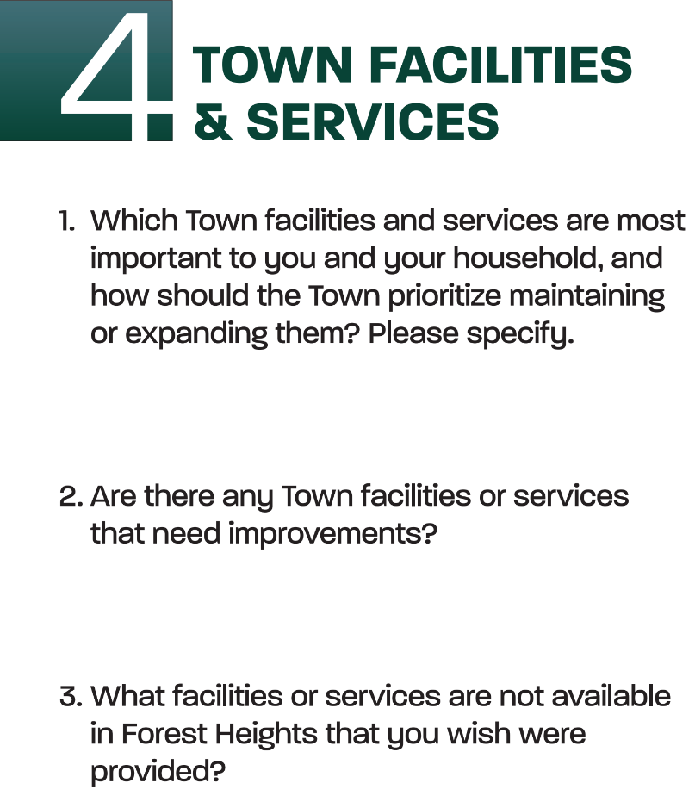
INTERACTIVE COMMUNITY STATIONS
  Cultural, Community, and Public Spaces
  Transportation and Mobility
  Housing Needs and Affordability
  Environment and Resilience
  Town Facilities and Services

Slide 9
Next Steps
Halloween Pop-Up: October 31, 2026
Focus Groups: October 2026 – December 2026*
Community Survey: November 2026 – December 2026*
  Project and Town websites, social media, mailers, physical posters, and hard copy available
Public Meeting #2: January 2027 – February 2027*
* Dates listed are tentative

Slide 10
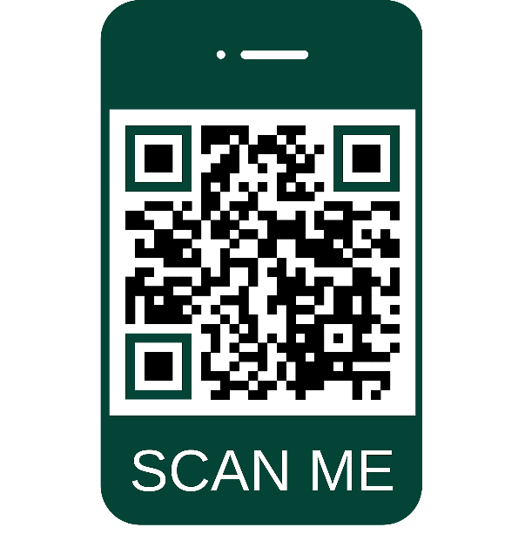
Thank you!
Project Website:
Project Contacts:
Connor Klein, Project Manager
connor.klein@ppd.mncppc.org
301-952-4609
Aaron Stiegler, Deputy Project Manager
aaron.stiegler@ppd.mncppc.org
301-952-3209
Neighborhood Revitalization Section
Community Planning Division
https://pgplanning.org/focus-areas/housing-neighborhoods/pamc/

