Slide 1


Slide 2
HOLD FOR VIDEO TO BE PROVIDED BY PGC ARTS & HUMANITIES COUNCIL

Slide 3

Topic: Impact of Economic Development
January 28, 2021

Slide 4

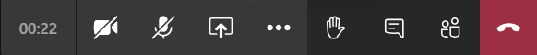
HOW TO PARTICPATE - TEAMS
  This meeting will be recorded and shared on the website.
  Please MUTE yourself and turn OFF your video until called upon.
  If you have a comment or question, type it in the chat.
  Unmute yourself if called upon.
TURN ON/TURN OFF CAMERA
MUTE/UNMUTE
OPEN MEETING CHAT

Slide 5
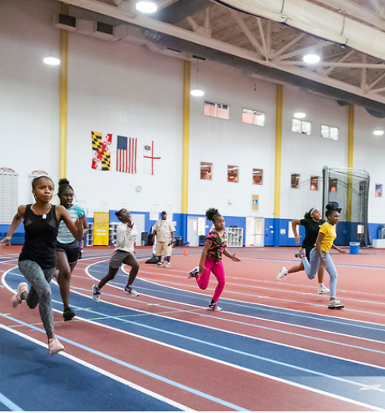

AGENDA
Welcome and Introductions
Project Overview
What’s Happening in Prince George’s County
Case Studies
Breakout Group Discussion
Plenary Q&A
Image Source: Maryland-National Capital Park & Planning Commission. Safe Summer Track and Field Showdown. Photo by Khalil Gill.

Slide 6
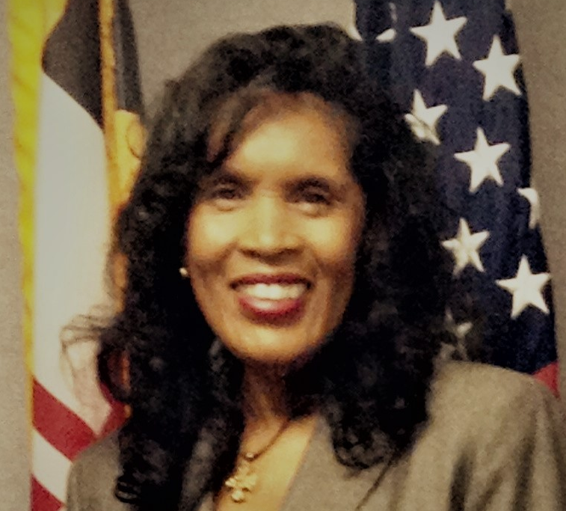
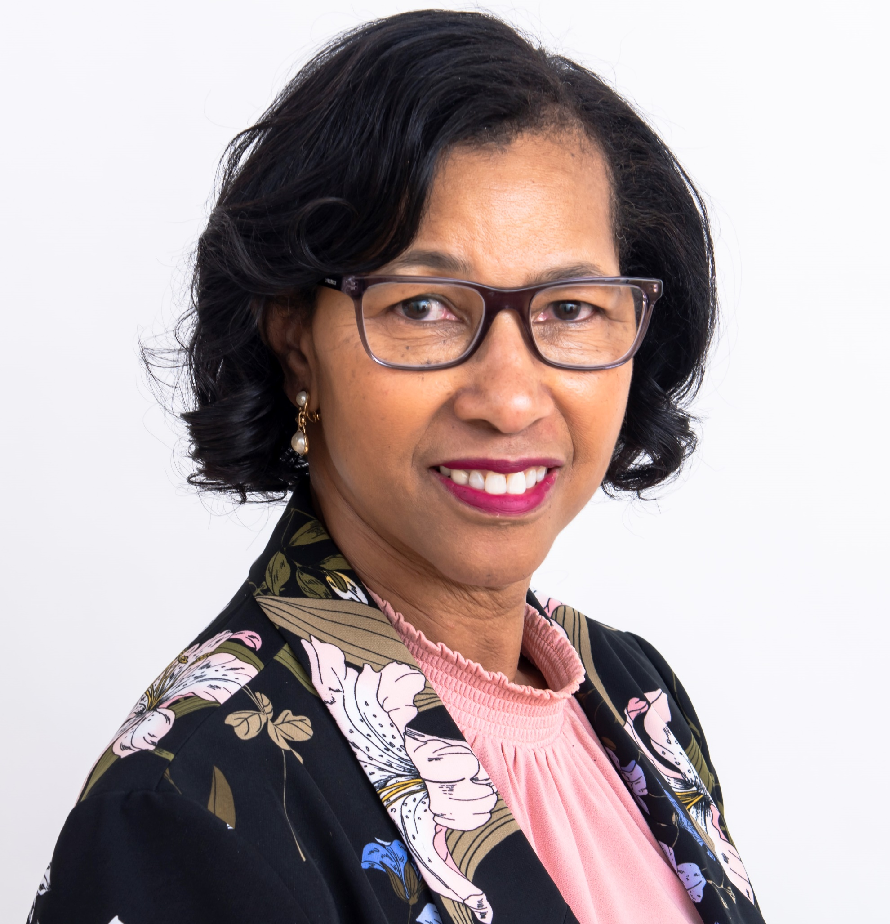
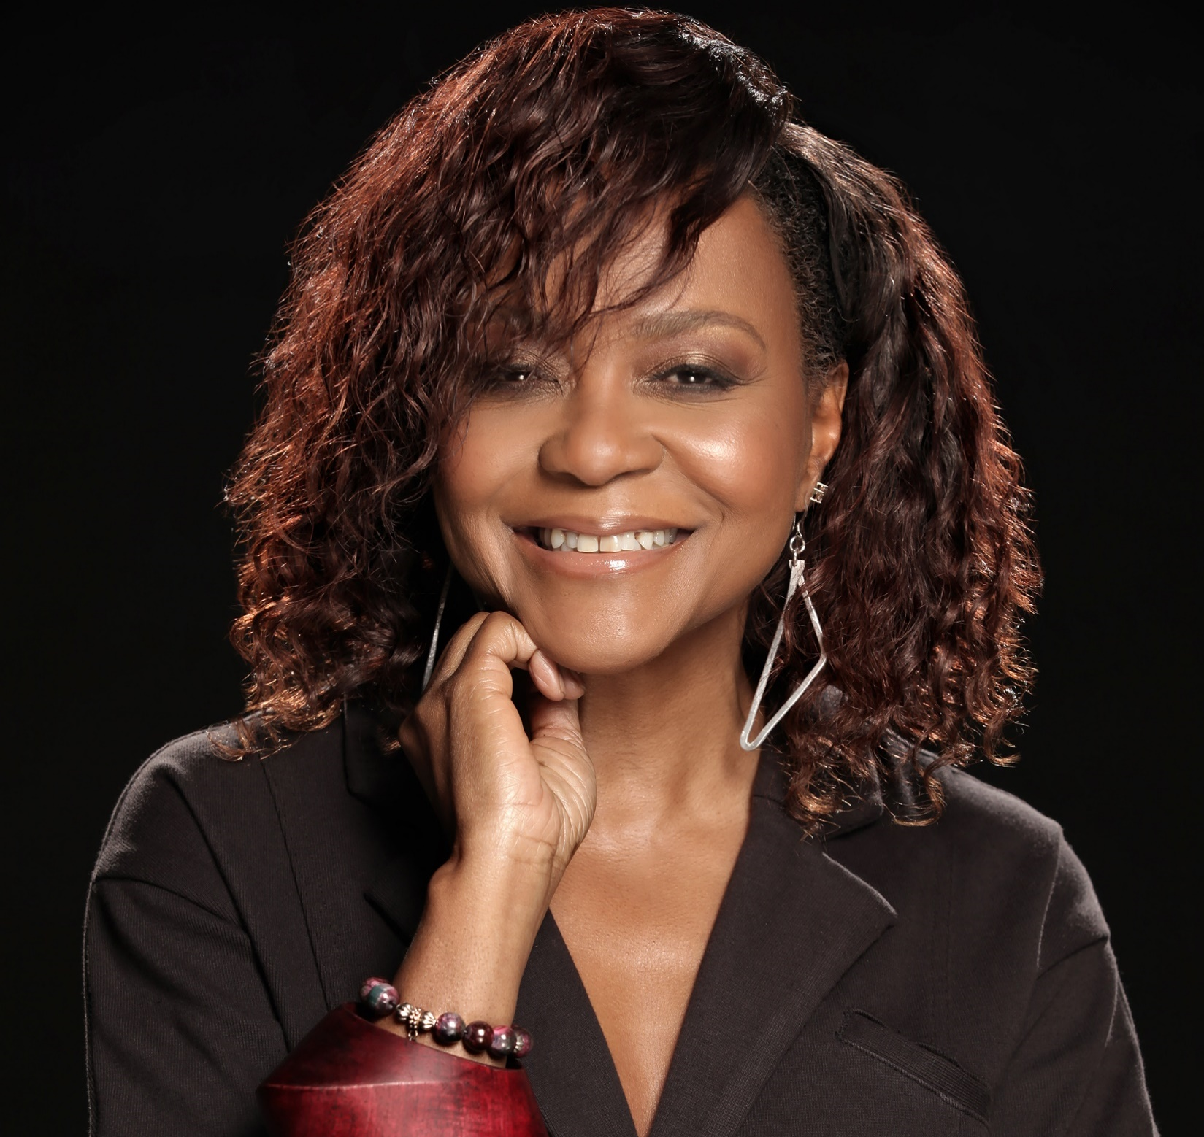
VANESSA AKINS,
Special Program Coordinator
Prince George’s County Planning Department
MEET THE TEAM
DARLENE WATKINS,
Division Chief, Arts and Cultural Heritage Division
Prince George’s County Department of Parks and Recreation
Prince George’s County Cultural Arts Study
RHONDA DALLAS,
Executive Director, Chief Curator
Prince George’s Arts and Humanities

Slide 7
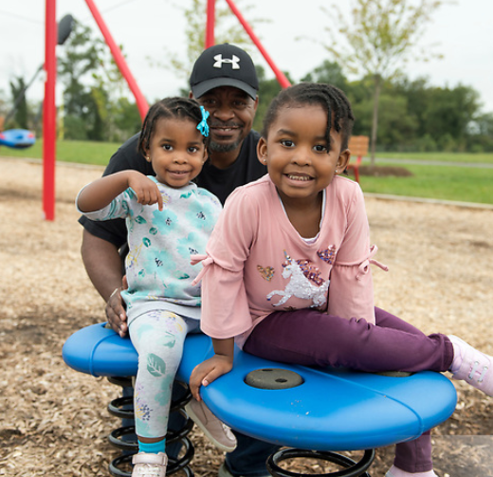
WHAT is the Cultural Arts Study?
The Prince George’s County Cultural Arts Study (PGCCAS) is a comprehensive assessment of the diverse arts and culture ecology in Prince George’s County
WHO is creating it?
Collaboration of Prince George’s County Planning Department, the Prince George’s Department of Parks and Recreation (DPR), and the Prince George’s Arts and Humanities Council
Working with a steering committee, arts advisors, and key stakeholders representing a broad spectrum of Prince George’s County voices
Inviting everyone in Prince George’s County to participate — please spread the word to YOUR communities!
Image Source: Maryland-National Capital Park & Planning Commission. Woodmore Towne Centre Opening. Photo By: Khalil Gill

Slide 8
YOUR PLANNING TEAM
JOY BAILEY BRYANT
Vice President, U.S.
Lord Cultural Resources
Project Lead
EVE MOROS ORTEGA, M.P.A
Senior Consultant
Lord Cultural Resources
Project Manager
TIFFANY LYONS
Research Consultant
Lord Cultural Resources
Research and Project Support
JON STOVER
Managing Partner
JS&A
Economic Development Strategy Lead
STAN WALL, P.E.
Partner
HR&A Advisors
Project Advisor, Economic Development Strategy

Slide 9
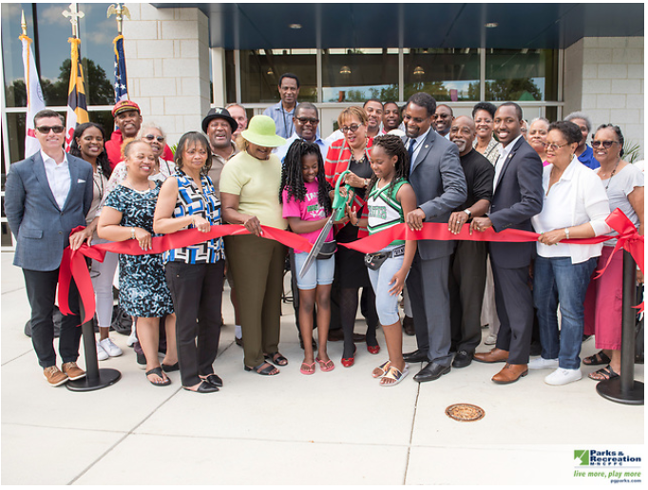
WHY?
Explore
Explore how the arts, culture, and entertainment can play a role in shaping the lives of Prince George’s County residents and the communities in which they live
Identify
Identify needed policy changes to ensure the cultural arts are included across all sectors
Ensure
Ensure that arts and culture are included throughout the County’s infrastructure as ways to advance cultural goals and creative placemaking
Increase
Increase opportunities for public art, community art projects, and infrastructure support for artists
Leverage
Leverage arts and culture as a game-changing urban revitalization strategy that will assist in improving the quality of life in our communities across the County
Image Source: Maryland-National Capital Park & Planning Commission.
Peppermill Community Center Opening Ceremony Photo By: Khalil Gill
Notes:
The purpose of this study is the overall integration of arts into the economic framework

Slide 10
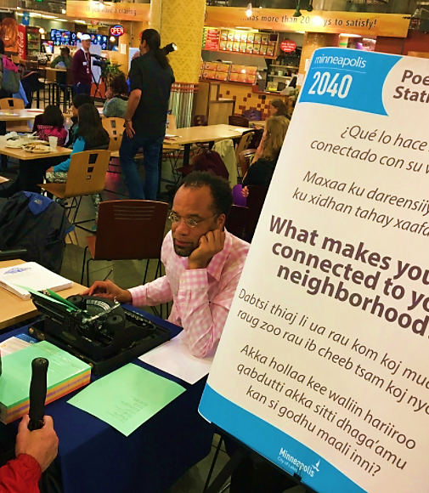
BUILDING
WITH CULTURE
Arts & Culture can address many community needs including:
Housing & Neighborhood Development
Education
Quality of Life
Talent Development/Retention
Economic Vitality
Tourism & Live/Work
Image Source: Americans for the Arts

Slide 11
HOW AND WHEN?
Economic Development
Report
Background Review
Stakeholder Interviews
6 Community Meetings
Cultural Participation Survey
Presentation of Key Findings
Draft Cultural Arts Study
Community Meeting
Final Cultural Arts Study
Summer 2020 – Fall 2021

Slide 12
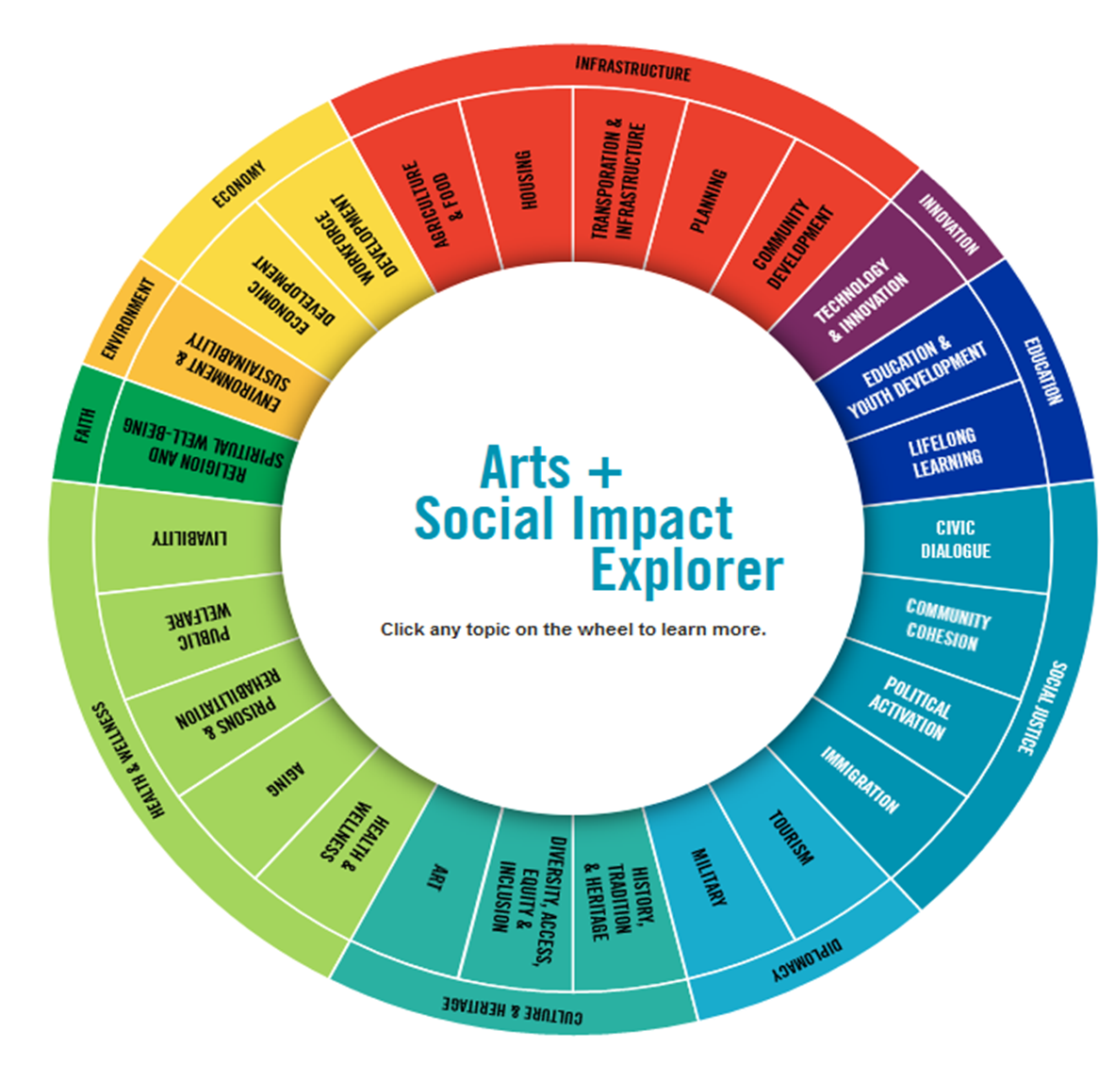
Topic: Impact of Economic Development
Arts and culture are a proven economic engine.
According to the U.S. Bureau of Economic Analysis, the arts contribute more than
$800 billion annually to U.S. economic output, amounting to more than 4% of GDP.
Arts and culture account for more economic activity than construction, transportation, and agriculture.
As of 2019, the arts were growing much faster — 4.2% per year — than did the overall U.S. economy — 2.2%.
Image Source: Americans for the Arts

Slide 13
Beyond direct economic impacts, arts and culture have powerful multiplier impacts.
For example, audiences for arts and cultural events often stay in hotels, eat in restaurants, pay for transportation, and shop at nearby retail. In addition to local consumers, the arts are a powerful draw for tourism.
Arts and culture can also create and provide great jobs, not only for artists, but also for the surrounding roles of administration, finance, legal counsel, and technical support.
The creative economy can range from ambitious large-scale cultural districts to smaller creative businesses, to individual makers, artists, and entrepreneurs.
Impact of Economic Development

Slide 14
WHAT’S HAPPENING IN PRINCE GEORGE’S COUNTY?

Slide 15
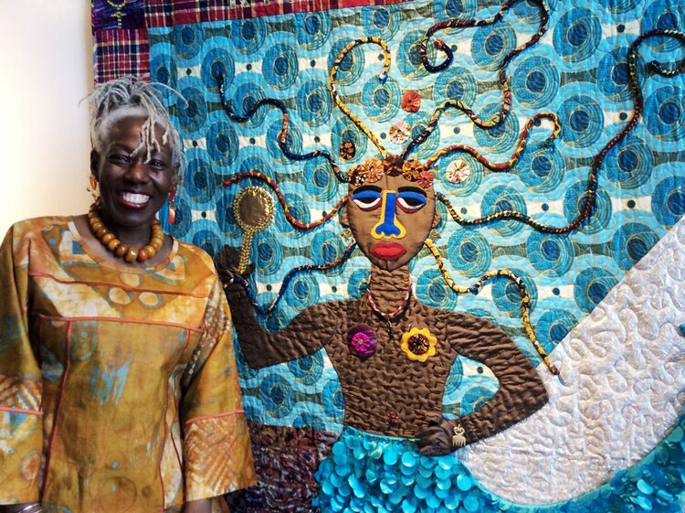
Wellspring Manor & Spa
Founded by husband and wife, Prince Georges County’s own, Lisa and Kevin Alexander. Wellspring Manor & Spa offers luxury accommodations and spa treatments while also hosting an Art Gallery on their grounds.
The Barn at Wellspring provides an art experience featuring paintings, sculptures, and other works of art by more than 35 artists of color from around
the world.
This business brings together both tourism and art in Prince Georges County. This example of Impact of Economic Development came to us through one of our Stakeholder Interviews.
Image Source: Wellspring Manor & Spa. The Barn at Wellspring.

Slide 16
HOLD FOR ADDITION BY PGCCAS PROJECT MANAGERS RHONDA DALLAS AND DARLENE WATKINS

Slide 17
HOLD FOR ADDITION BY PGCCAS PROJECT MANAGERS RHONDA DALLAS AND DARLENE WATKINS

Slide 18
Case Studies: Impact of Economic Development
SPROUT GROWERS & MAKERS MARKETPLACE: REGION FIVE DEVELOPMENT COMMISSION
Little Falls, Minnesota
DETROIT AFRIKAN MUSIC INSTITUTION:
The APEX Project
Detroit Michigan

Slide 19
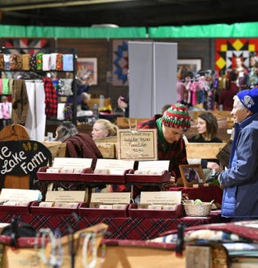
REGION FIVE DEVELOPMENT COMMISSION (R5DC):
SPROUT GROWERS & MAKERS MARKETPLACE
Little Falls, Minnesota
R5DC is supporting an economic development opportunity that uses culinary art, functional and non-functional art installations, and experiences that intend to make Sprout Growers & Makers Marketplace in Little Falls a destination as well a reflection of the unique cultural diversity of central Minnesota.
Sprout Growers & Makers Marketplace is a newly constructed 20,000-square-foot local food processing facility, cooking demonstration kitchen and indoor winter marketplace for growers and makers, established by a cadre of thinkers over the past 6 years who hosted its grand opening April 1, 2016.
Sprout Marketplace offers a unique community engagement setting that creatively engages residents to design projects and intrinsic/social programming at a one-of-a-kind regional space where art/culture/food increase cultural appreciation and offer positive economic impacts.
Image Source: Growers and Makers Marketplace event at Sprout food hub in Little Falls. Photo by Dave Schwarz, dschwarz@stcloudtimes.com

Slide 20
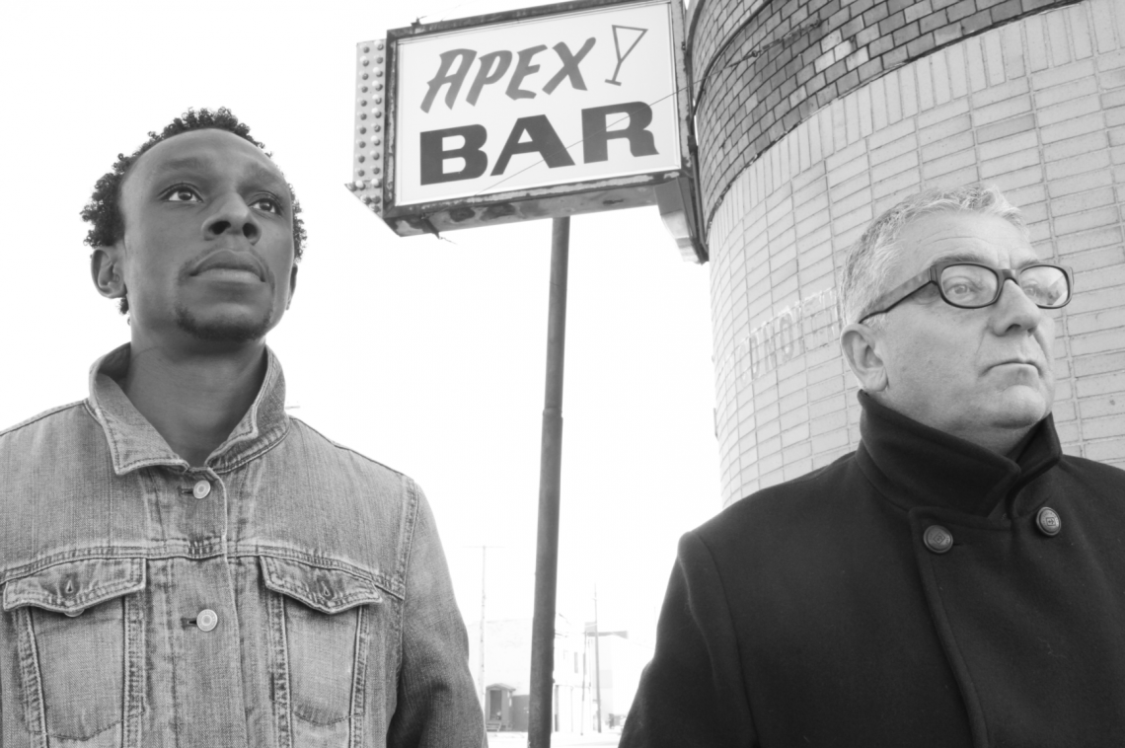
DETROIT AFRIKAN MUSIC INSTITUTION:
THE APEX PROJECT
Detroit, Michigan
The Detroit African Music Institution will work with local architects and designers to rehab the historic Apex Lounge on Oakland Avenue in Detroit, MI's North End neighborhood. Historically, this neighborhood was Detroit’s premiere African-American music district.
The Apex Lounge will transform from a vacant property into a center for education, rehearsal, and performance that will serve as a catalyst for reigniting Detroit’s music economy.
Image Source: ArtPlace, The Apex Project.
Photo by Piper Carter

Slide 21

BREAKOUT ROOMS

Slide 22
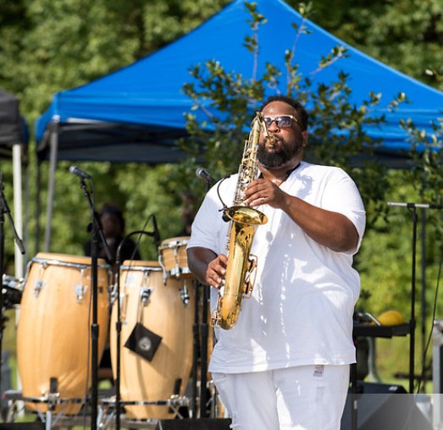
Discussion Questions
What are the strengths of the county’s arts and cultural landscape from an economic development perspective — both the marquee institutions and those cultural assets that may be less well-known but steady drivers of economic activity?
How can arts and culture support economic development in your community?
What are key opportunities for arts and culture to provide jobs, workforce training, income, and to otherwise assist the county’s economic landscape?
Image Source: MARYLAND-NATIONAL CAPITAL PARK AND PLANNING COMMISSION. Fairwood Community Park Music Festival / 2019.
Photo By: Khalil Gill

Slide 23
REPORT BACK

Slide 24
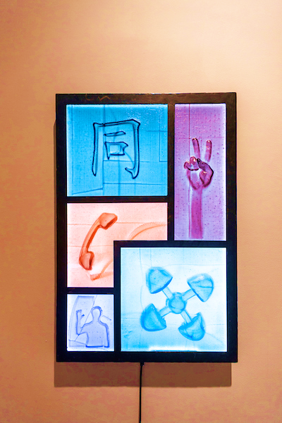
Q&A
Please take yourself off mute and/or enter your questions in the chat box now.
Image source: M-NCPPC, Department of Parks and Recreation, Prince George's County,
Photographer -Claude Langley Jr.

Slide 25
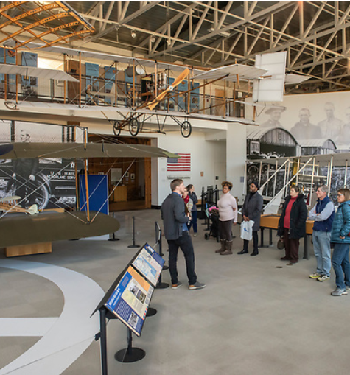
WHAT’S NEXT?
Take and promote the cultural participation survey:
https://www.surveymonkey.com/r/PGCCAStudy
Go to http://www.mncppc.org/4860/Cultural-Arts-Study to follow the process
Volunteer to host Community Culture Circles conversations with friends and family about the ways they are, and would like to, experience arts and culture in Prince George’s County
Spread the word to everyone in YOUR community!
Image Source: M-NCPPC, Department of Parks and Recreation, Prince George's County. AFRICAN AMERICAN AVIATORS TOUR. Photo By: Khalil Gill

Slide 26
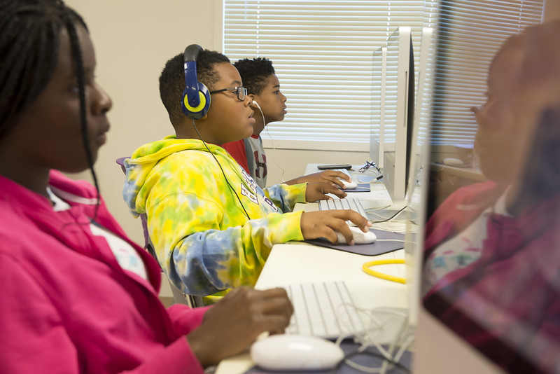

CONTACT US
PGCCAS@ppd.mncppc.org

Slide 27
THANK YOU FOR YOUR PARTICIPATION!
STAY INVOLVED!
http://www.mncppc.org/4860/Cultural-Arts-Study

